Slide 1
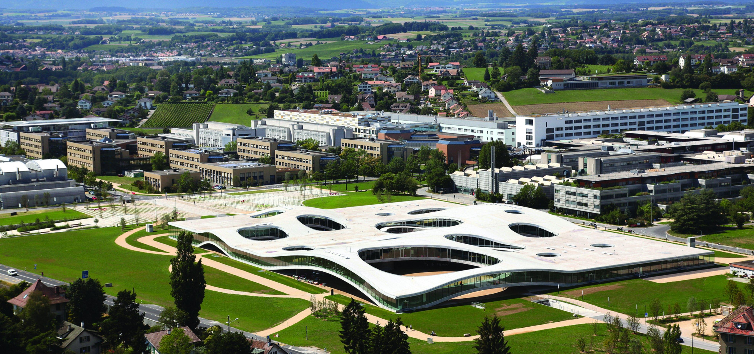
Action Recognition for Self-Driving Cars
Semester Project
VITA EPFL
Student: Weijiang Xiong
Supervisor: Lorenzo Bertoni, Taylor Mordan
Date:
Notes:
Hi everyone, I’m Weijiang Xiong, and I’m very happy to share with you my findings during the summer project
my project is a topic under the broad context of Bayesian deep learning, and I mainly worked on normalizing flows for implicite Bayesian neural networks

Slide 2
Project Motivation

Slide 3
Results on TCG 4-Class Classification
Method | Cross-subject |  |  | Cross-view
Method | Accuracy | Jaccard | F1 | Accuracy | Jaccard | F1
RNN | 82.81 | 57.40 | 69.45 | 80.94 | 57.21 | 69.98
GRU | 84.44 | 58.16 | 70.45 | 83.47 | 56.25 | 68.59
LSTM | 83.23 | 56.32 | 68.59 | 79.58 | 52.02 | 64.62
Att-LSTM | 85.67 | 50.70 | 61.87 | 85.30 | 59.87 | 71.20
Bi-GRU | 86.80 | 57.25 | 68.95 | 87.37 | 55.55 | 67.68
Bi-LSTM | 87.24 | 67.00 | 78.48 | 86.66 | 65.95 | 77.14
TCN | 83.44 | 62.06 | 74.23 | 82.66 | 63.97 | 75.95
GCN | 65.42 | 38.55 | 50.73 | 62.40 | 35.05 | 48.51
MonoLoco | 84.68 | 64.31 | 76.98 | 86.01 | 65.63 | 78.47
MonoLoco+LSTM | 83.79 | 47.96 | 57.56 | 84.53 | 50.09 | 59.42

Slide 4
(TODO) Action Recogntion mAP on TITAN
 | Method | I3D | 3D ResNet | MonoLoco
 | Backbone | InceptionV1 | ResNet50
Person | atomic | 0.9219 | 0.7552
 | simple | 0.5318 | 0.3173
 | complex | 0.9881 | 0.9880
 | communicative | 0.8649 | 0.8648
 | transportive | 0.9080 | 0.9081
 | overall | 0.8429 | 0.7667
Vehicle | motion | 0.9918 | 0.7132
 | trunk | 1.00 | 1.00
 | doors | 1.00 | 1.00
 | overall | 0.9921 | 0.9044
Overall |  | 0.8946 | 0.8128

Slide 5
Contents
Point 1
Point 2
Point 3
Point 4

